Slide 1
We Are Oceania: Oregon’s Pacific Islander Community System
Oregon Resource Allocation Advisory Committee November 29, 2022
Presented by: Alyshia Alohalani Macaysa-Feracota

Slide 2
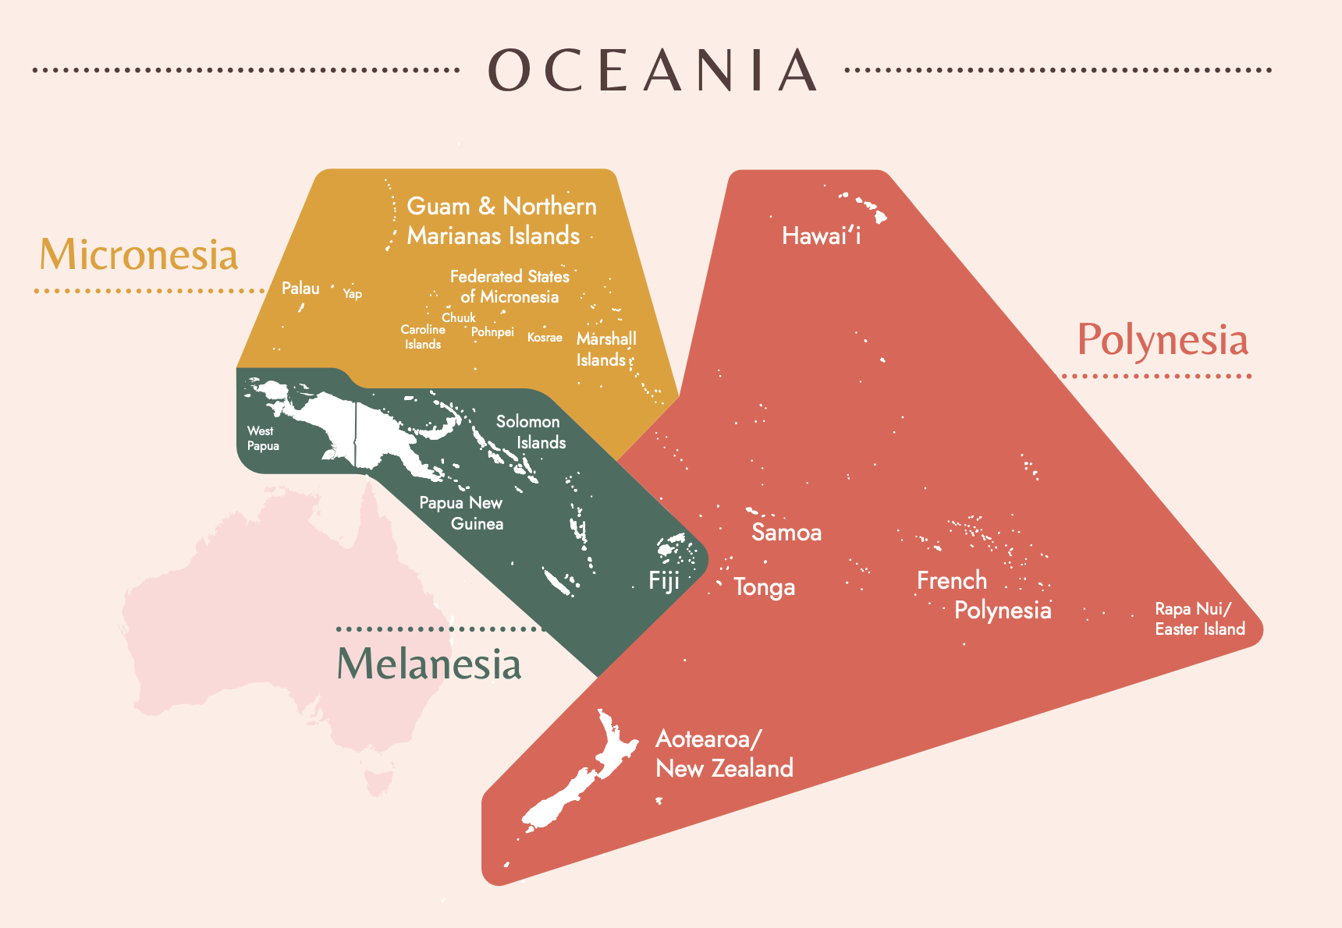
Who are Pacific Islanders?

Slide 3
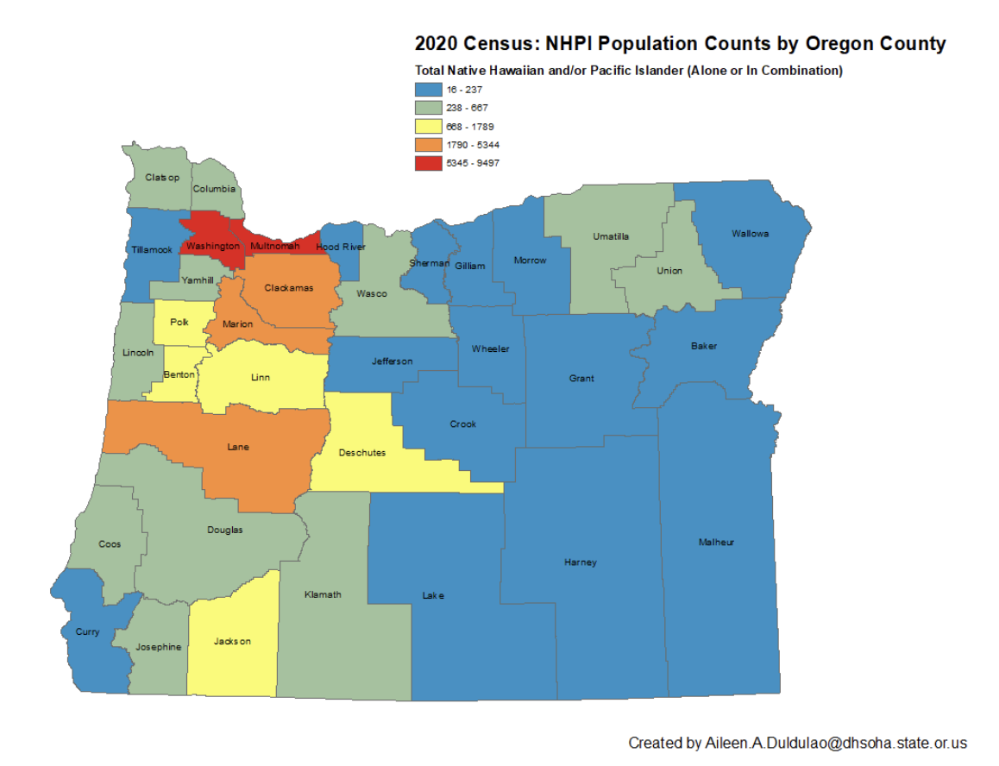
Oregon’s PI Communities
Estimated 39,709 Pacific Islanders in Oregon
Variety of citizenship statuses: forced US citizen, US citizen, US national, COFA citizen, undocumented, etc.
Oregon is 1 of 10 states with the largest PI population

Slide 4
Community System

Slide 5
Forces of Pacific Islander Oppression
Active colonization and militarization of the Pacific – stolen land, stolen nourishment
Aggregate data categories (i.e., API, NHPI) and poor research
Structural disinvestment due to aggregate funding & community engagement
Queermisia and Transmisia perpetuated by colonialism

Slide 6
“It is critical to understand that NHPIs are distinct from Asian Americans, and these 2 groups were legally disaggregated during the Clinton administration.² NHPI nations contain no Asian countries and do not share any unifying history with Asian nations. Thus, using the antiquated term “Asian Americans and Pacific Islanders” (or “AAPI”) obscures the health disparities and oppression specific to the NHPI experience. When disaggregated, Native Hawaiians have shorter life spans and higher incidence of diabetes, asthma, substance abuse, and obesity compared with all major Asian American ethnic groups.”
- Kekoa Taparra, MD,PhD

Slide 7
Oppression’s Lasting Impact
One Pacific Islander specific public health specialist in the entire state of Oregon to respond to the pandemic
Between April 2020 – Feb 2021 UCLA’s NHPI Data & Policy Research Lab noted PIs had the “highest per capita death rate in 18 of 20 US states reporting NHPI deaths.”
Poorly funded organizations with non-paid leaders operating over capacity
Loss of significant portions of Oregon’s PI community, including elders, orators, and cultural practitioners

Slide 8
Questions? alyshia@alyshiamacaysa.com Alyshia | ORAAC Facilitator

